Slide 1

Phân loại lá cây xoài bệnh
GVHD: Ths.Nguyễn Tăng Trí Đức

Slide 2

Nhóm
Nguyễn Xuân Tính
Lâm Phát Tài
Trần Gia Phát
Lâm Hoàng Khánh

Slide 3
NỘI DUNG
Collect data
EDA
Modelling
Error Analysis

Slide 4
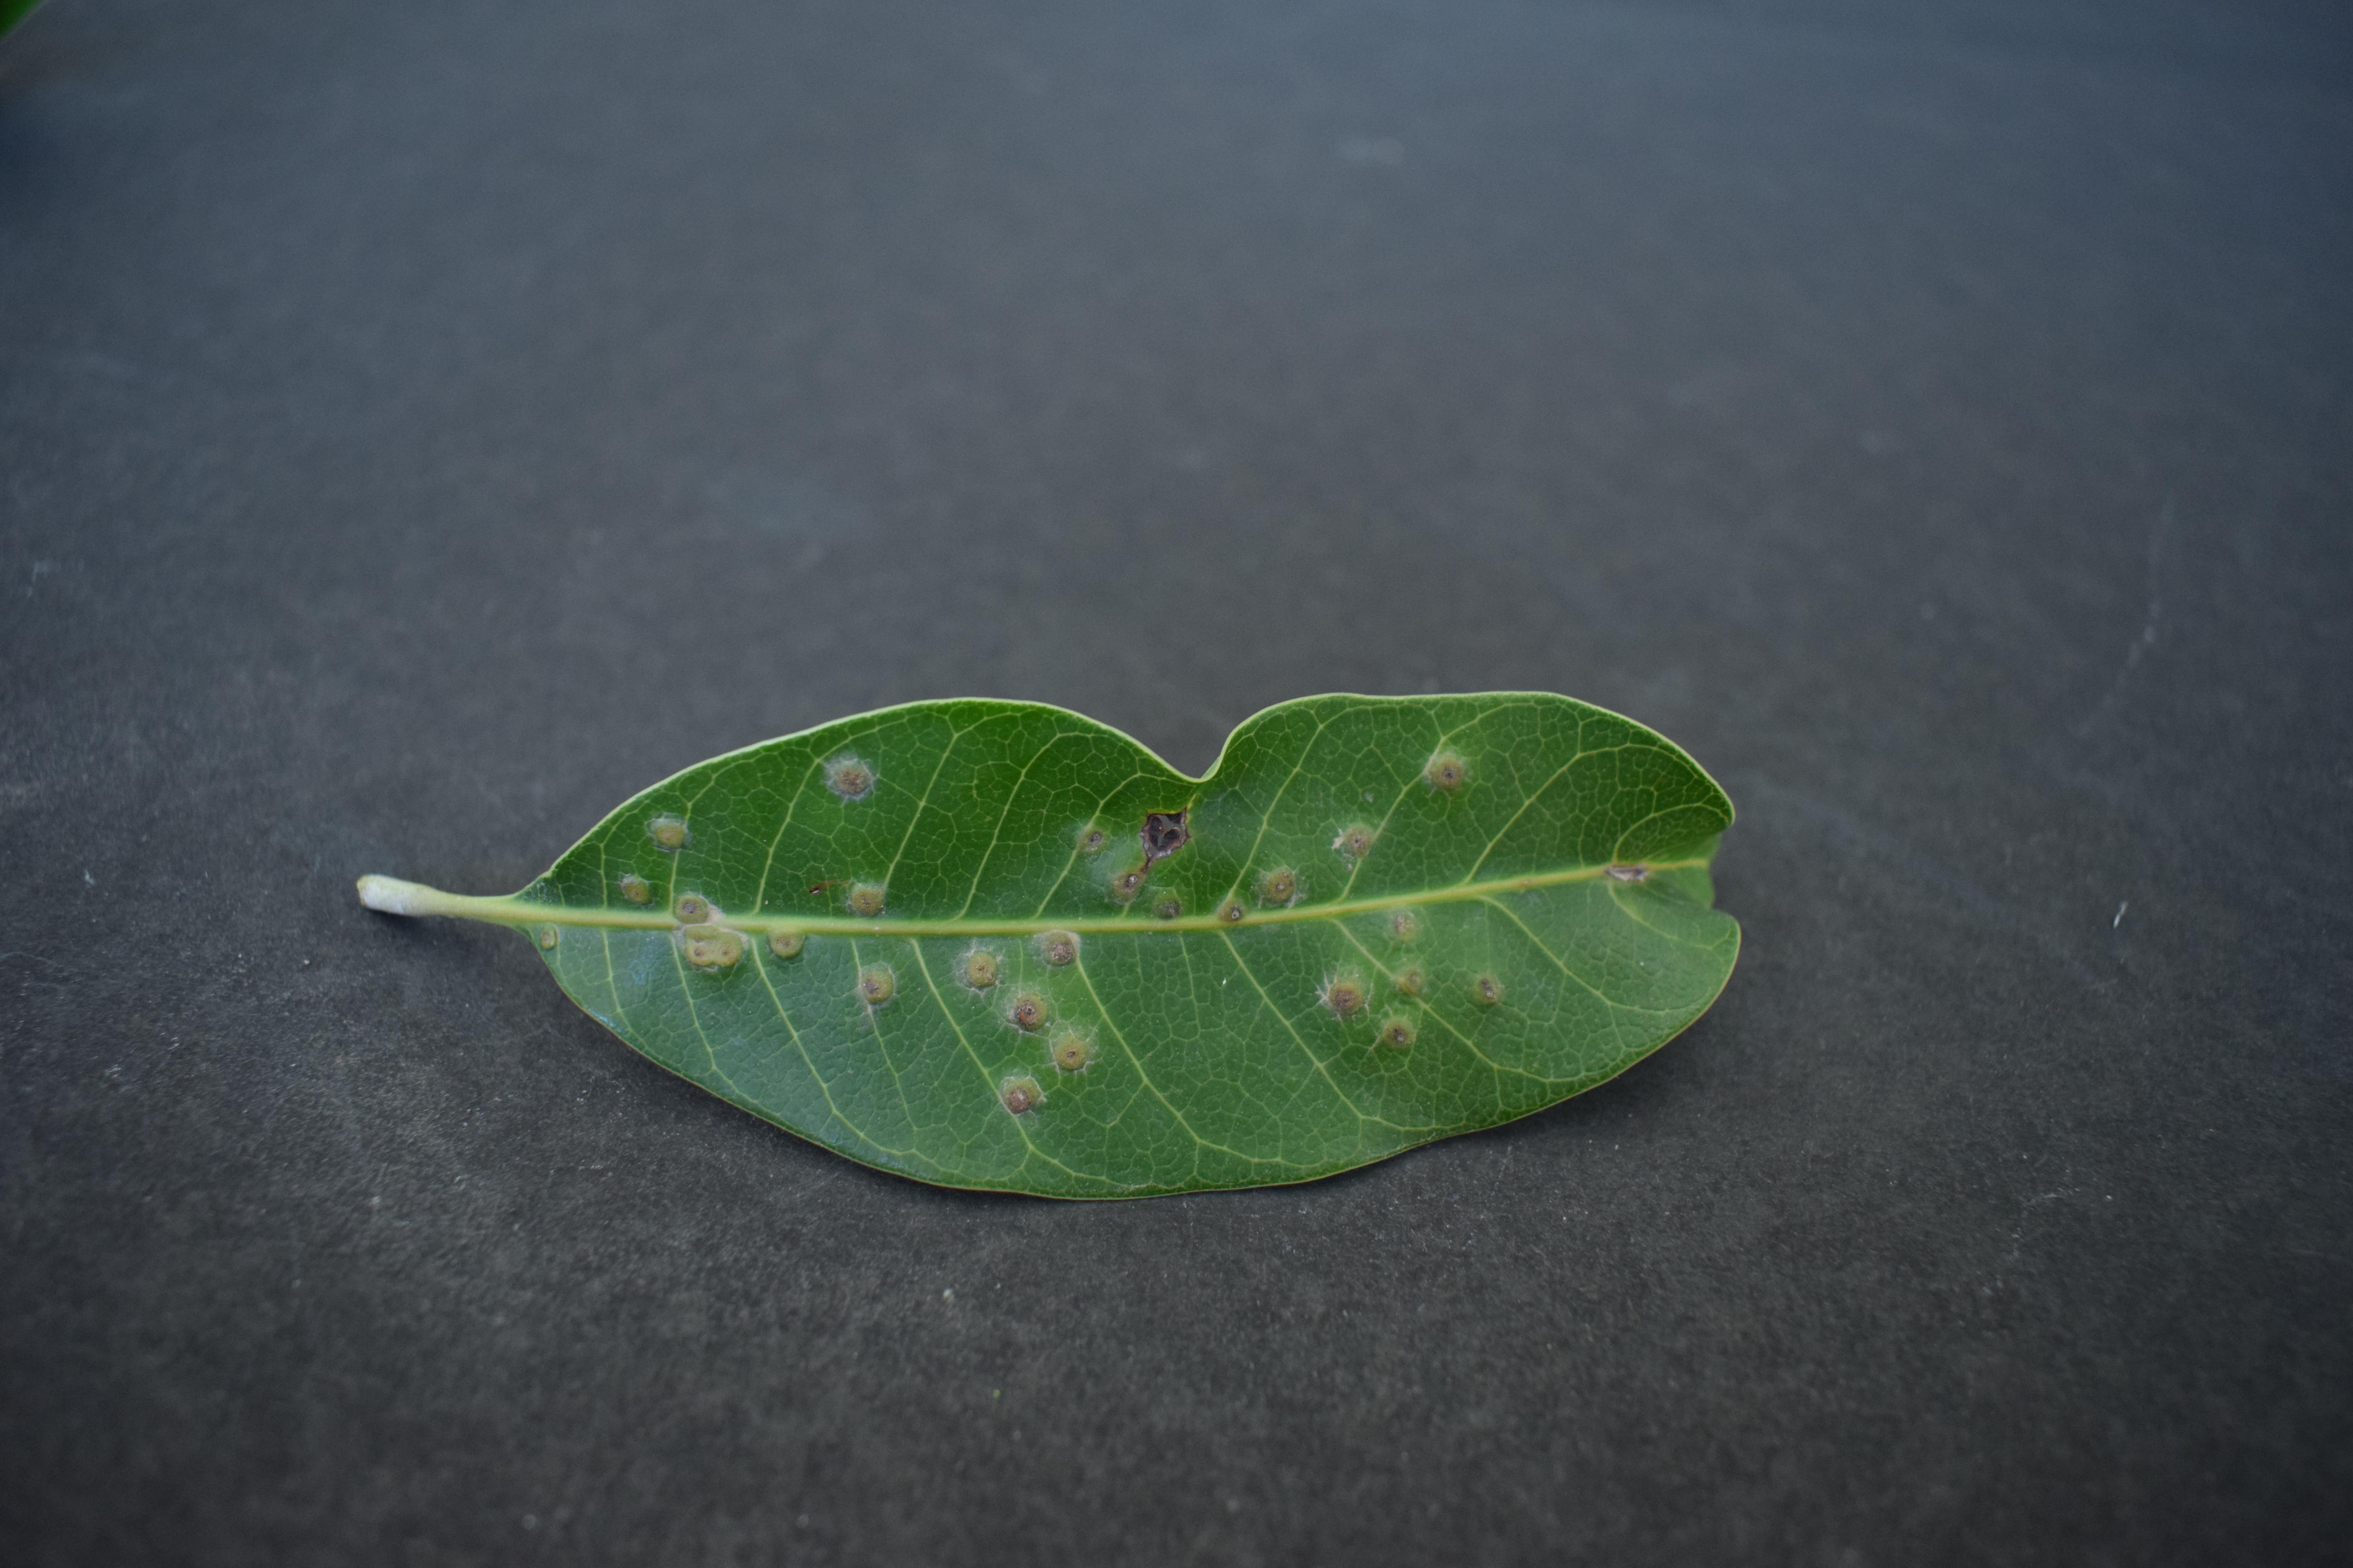
Giới thiệu
MÔ TẢ BÀI TOÁN
Xây dựng mô hình phân biệt lá bệnh và lá khỏe ở cây xoài
INPUT – OUTPUT
LEAF CLASSIFICATION MODEL
0 (lá khỏe)
1 (lá bệnh)
INPUT
OUTPUT

Slide 5
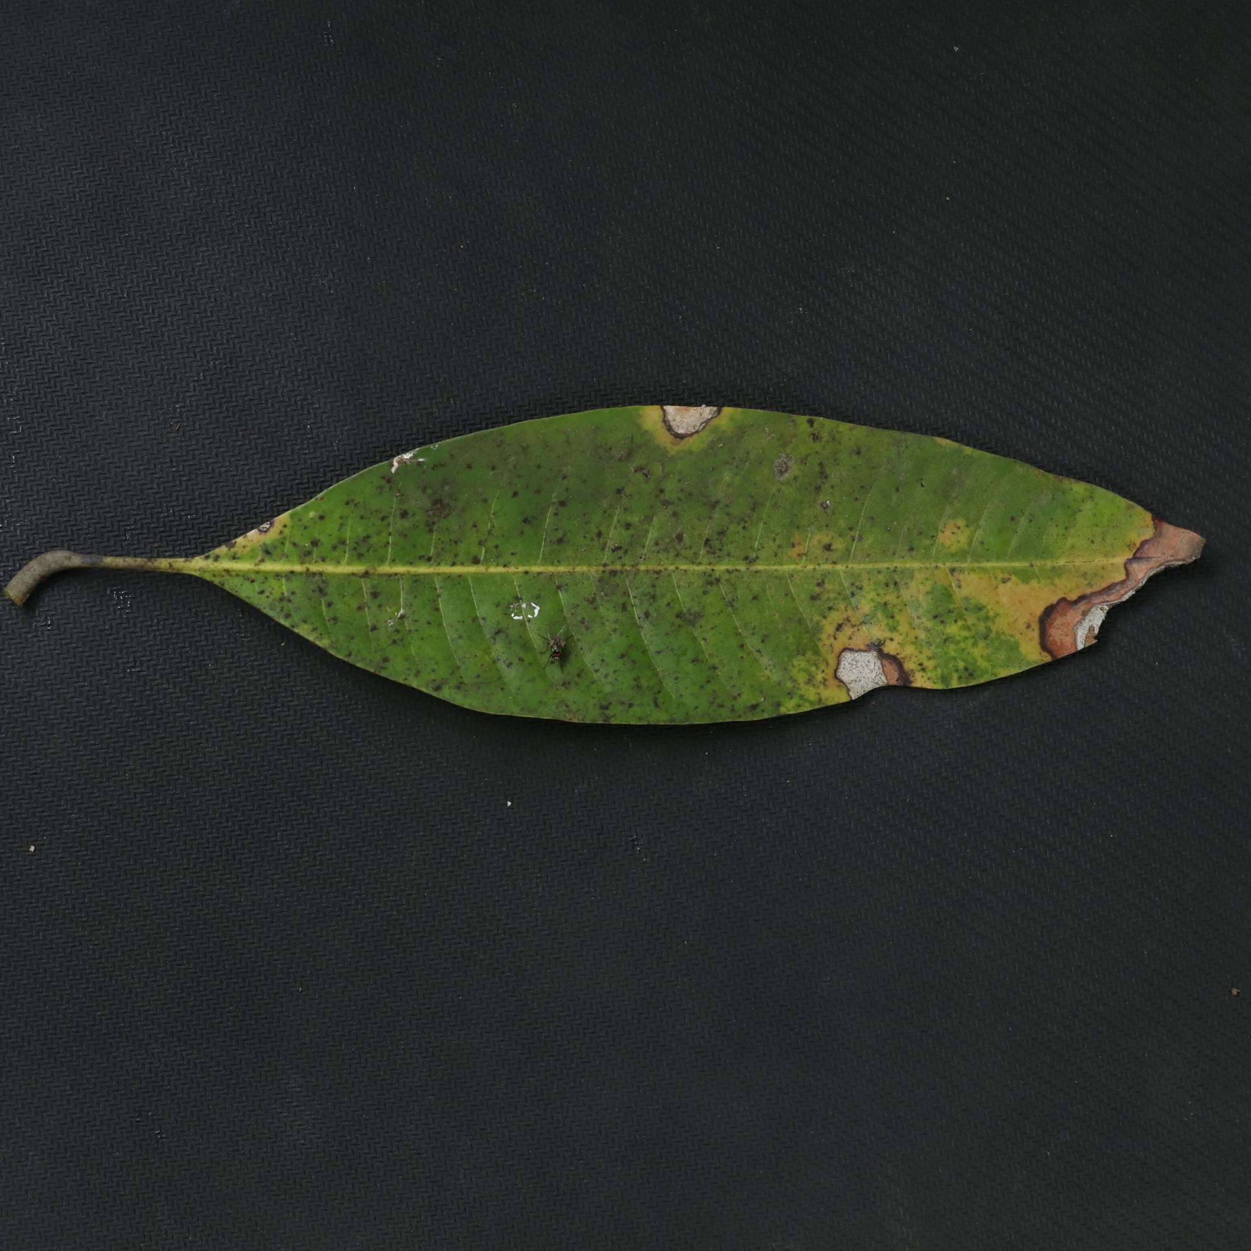
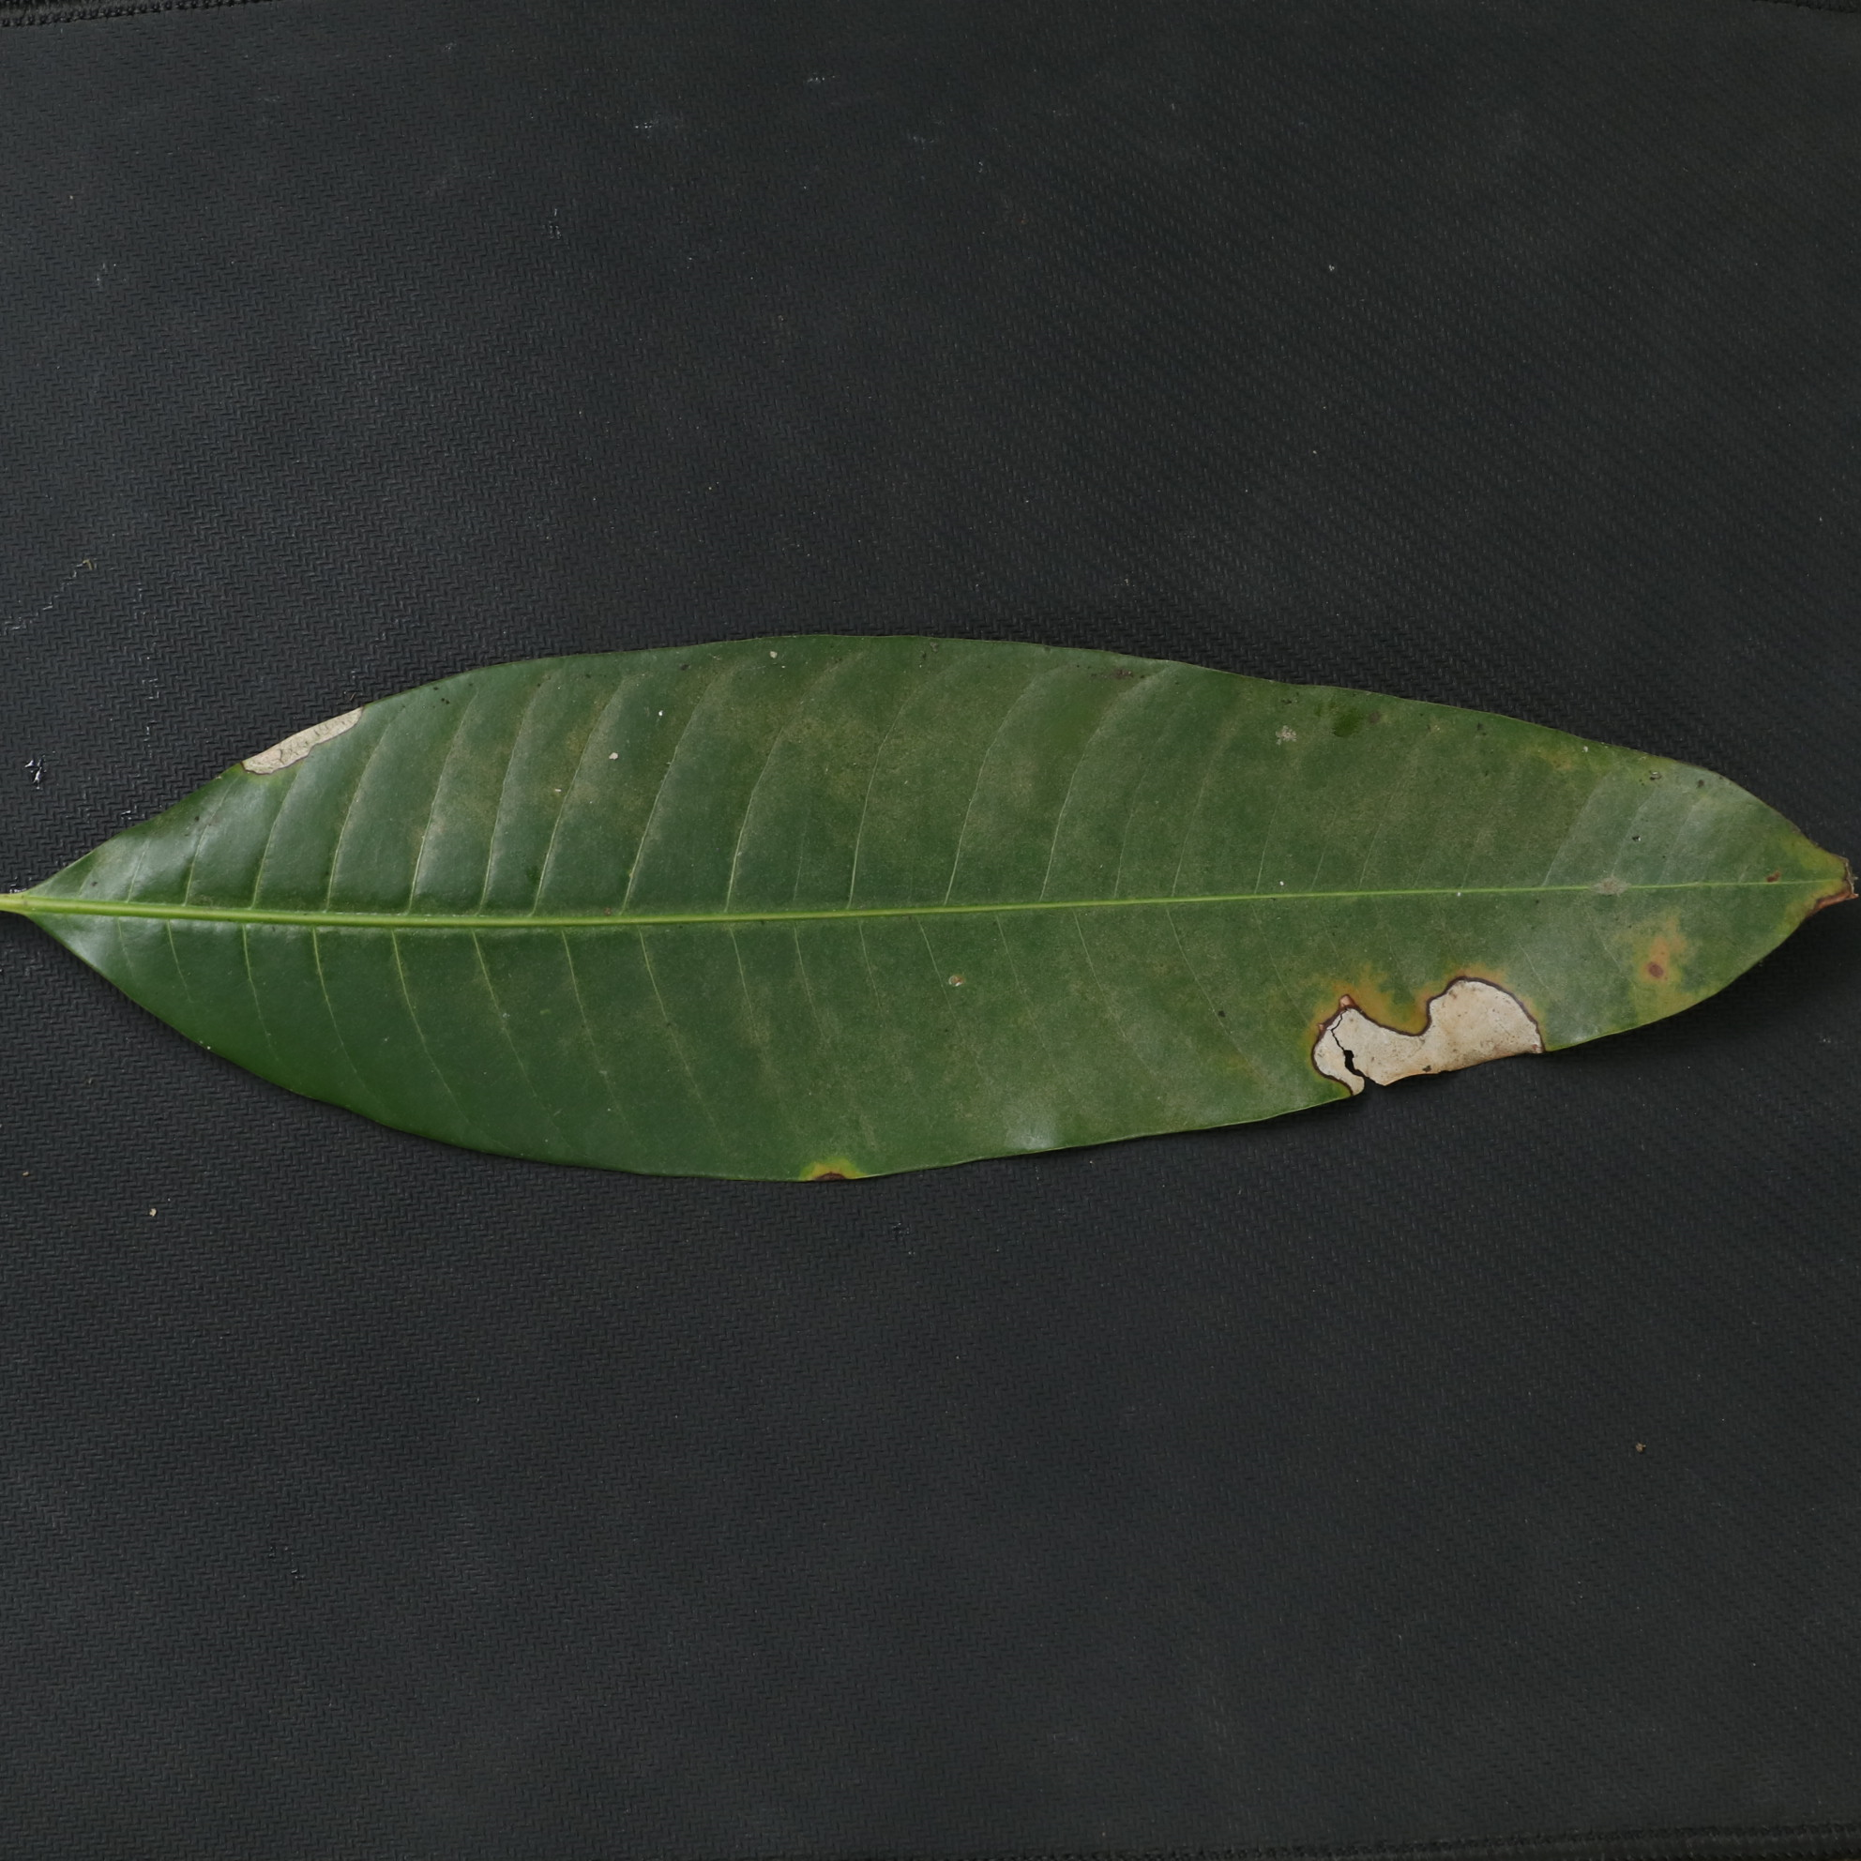
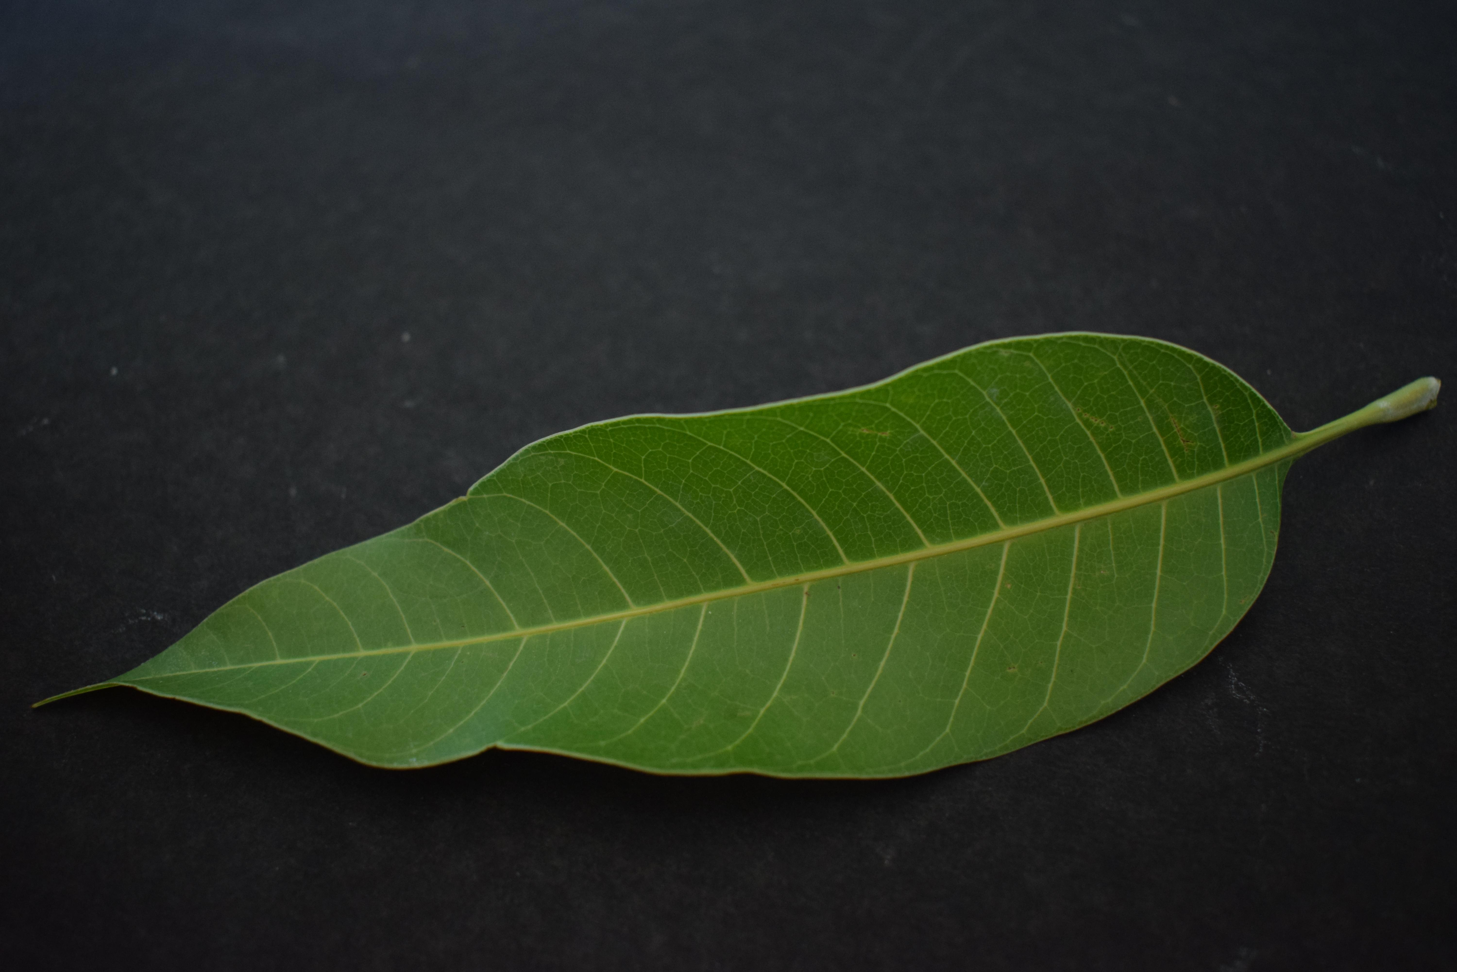
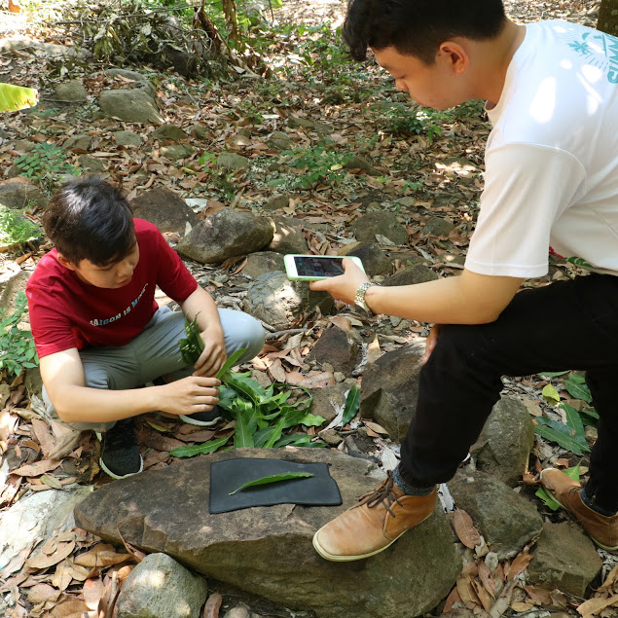
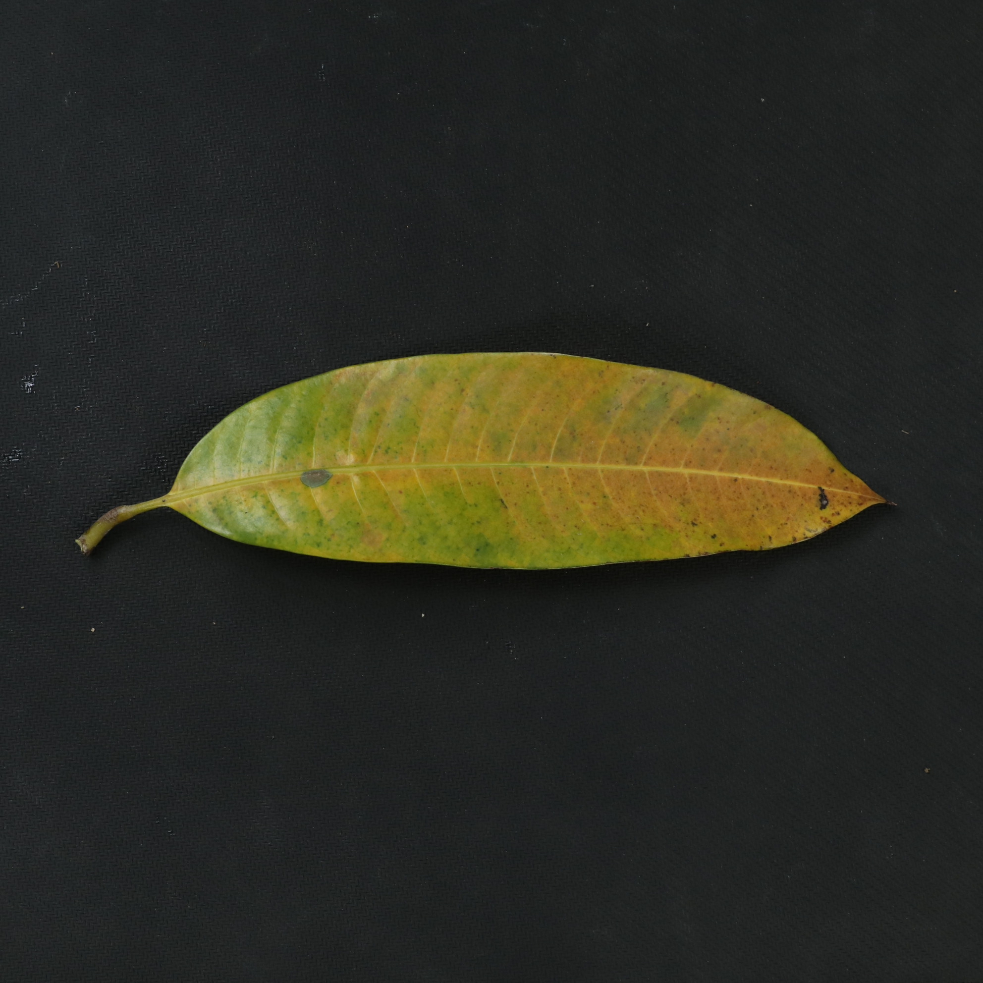



Collect data
 | Lá khỏe | Lá bệnh
Canon 80D | 500 | 500
Iphone 6s plus | 525 | 382
Kaggle | 170 | 265
 | 1195 | 1147
Ma Thiên Lãnh, Tây Ninh
https://www.kaggle.com/agbajeabdullateef/a-database-of-leaf-images-from-mendeley-data

Slide 6

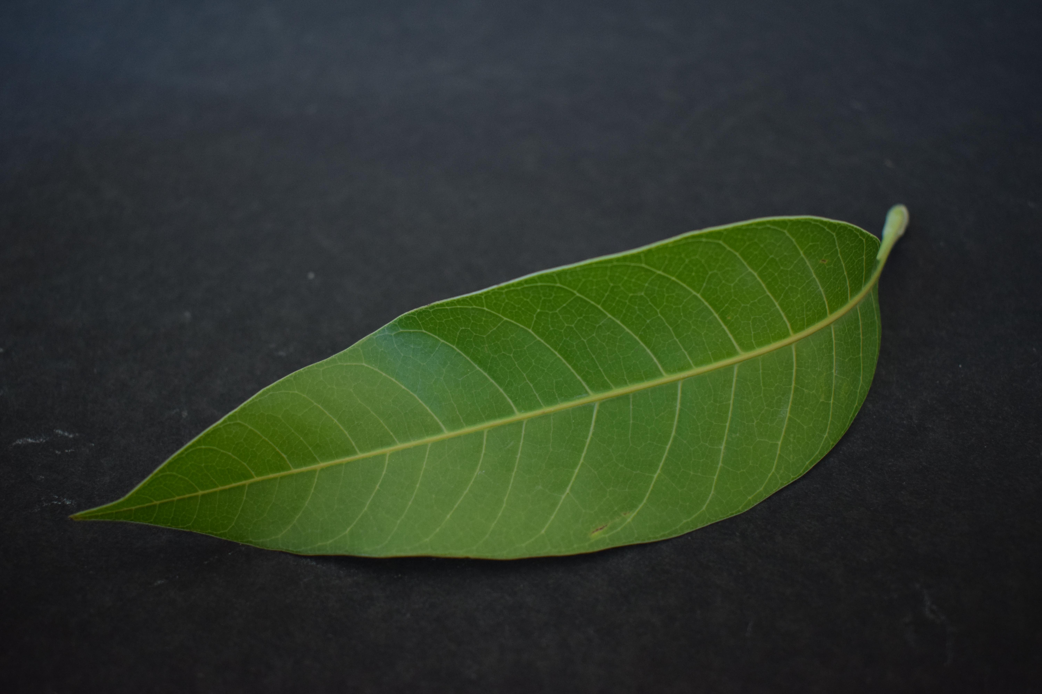
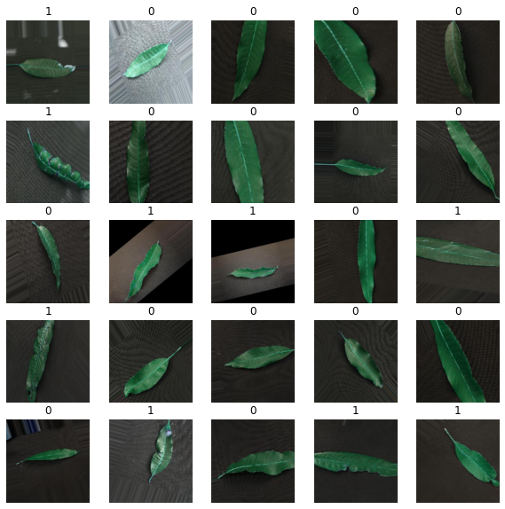
EDA
Padding
Resize [256,256]
Data Augementation

Slide 7
EDA

Slide 8
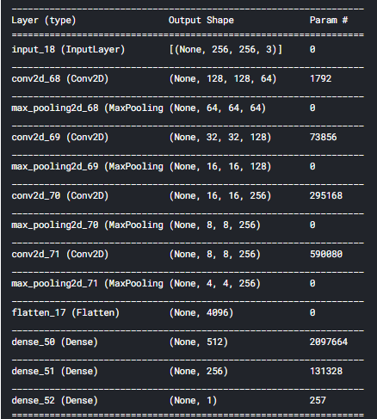
modelling
Xây dựng kiến trúc CNN

Slide 9
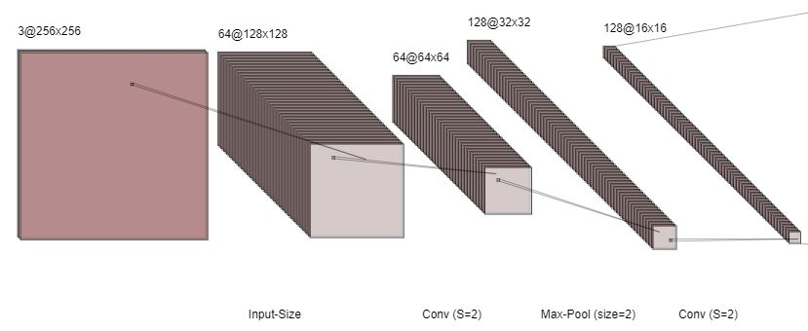
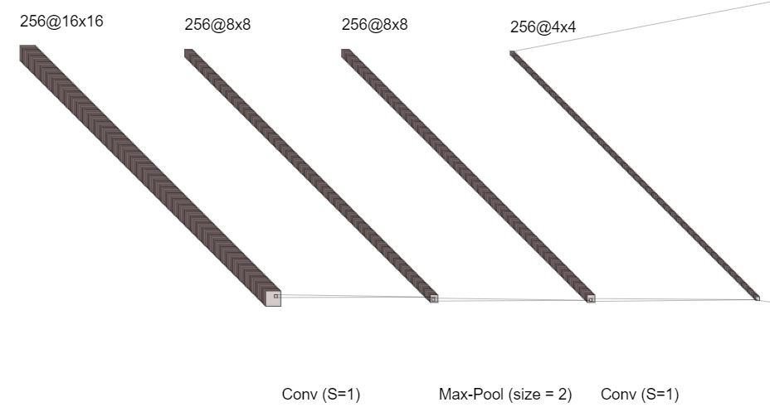
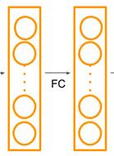





modelling
Xây dựng kiến trúc CNN
Max-Pool (size = 2)
Fully
Connected Layer
1
Sigmoid
4096
512
256
Max-Pool (size = 2)

Slide 10
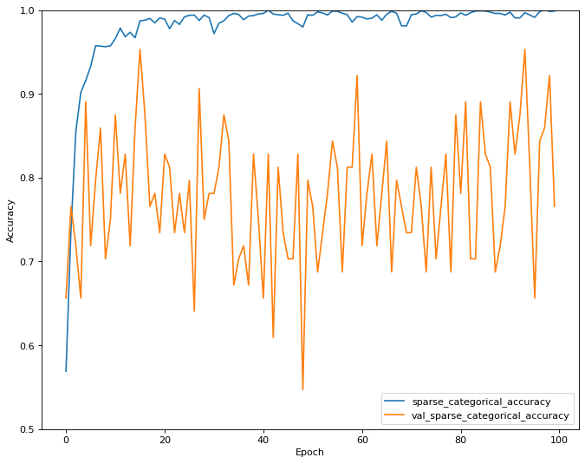
ERRoR Analysis
Overfit
Model chưa phù hợp
Lượng data chưa đủ.
Shift Distribution.

Slide 11
Data augmentation

Slide 12
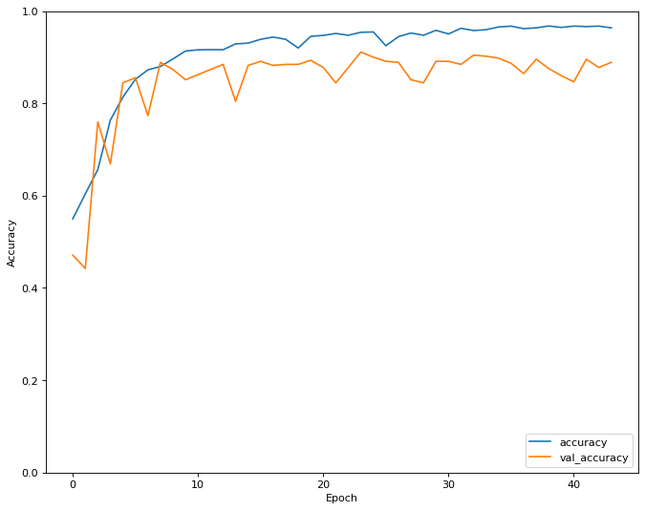
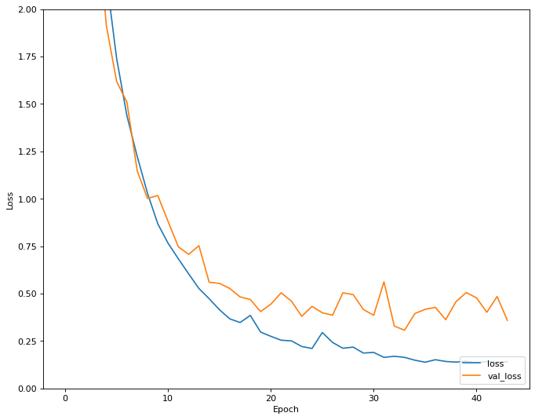
EVAluation
Learning curve
Accuracy:
on_Train: 96.05%
on_Valid: 90.03%
on_Test: 88. 96%

Slide 13
Report
Subtitle
Subtitle
Subtitle
Add text, images, art, and videos.
Add transitions, animations, and motion.
Save to OneDrive, to get to your presentations from your computer, tablet, or phone.
Add text, images, art, and videos.
Add transitions, animations, and motion.
Save to OneDrive, to get to your presentations from your computer, tablet, or phone.
Add text, images, art, and videos.
Add transitions, animations, and motion.
Save to OneDrive, to get to your presentations from your computer, tablet, or phone.

Slide 14



Summary
With PowerPoint, you can create presentations and share your work with others, wherever they are. Type the text you want here to get started. You can also add images, art, and videos on this template. Save to OneDrive and access your presentations from your computer, tablet, or phone. ​

Slide 15
THANK YOU

